Slide 1
Linear momentum
MS864M

Slide 2
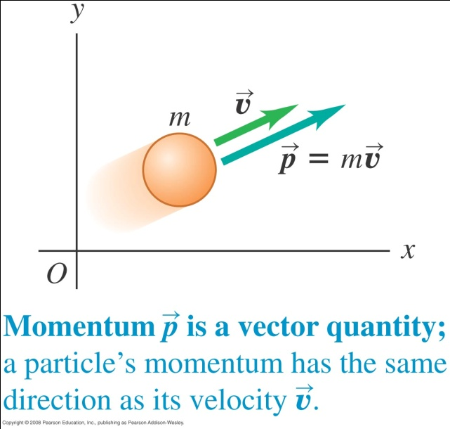
Linear momentum
In this lesson we will study linear momentum, which is useful for studying collision scenarios.
Linear momentum is defined as
where m is mass in kg and is velocity in m/s. Hence the unit of linear momentum is kg m/s.
Linear momentum is a vector. It’s components are :

Slide 3
Newton’s second law
In terms of linear momentum, Newton’s second law is
In words, the net force acting on a particle equals the time rate of change of the linear momentum of the particle.
A rapid change in momentum requires a large force while a gradual change in momentum requires less force.
If the mass m is constant and a is uniform, then

Slide 4
Impulse-momentum theorem
If the net force on the mass is constant,
We can write the above as
The term is known as impulse. It is a vector quantity and its direction is in the direction of the net force.
The SI unit of impulse is N s.
The above relation is known as the impulse-momentum theorem.

Slide 5
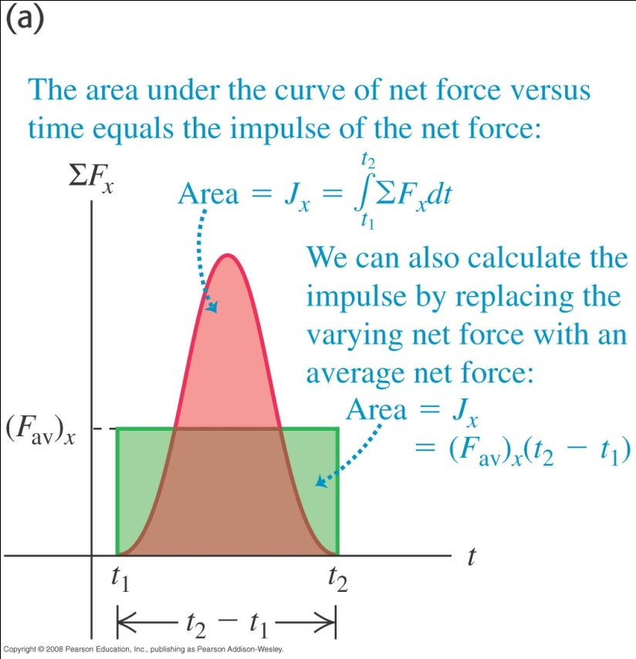
Impulse-momentum theorem
If the net force is not constant
We can define an average net force which gives the same area as the varying net force, i.e.
The magnitude of the components are:

Slide 6
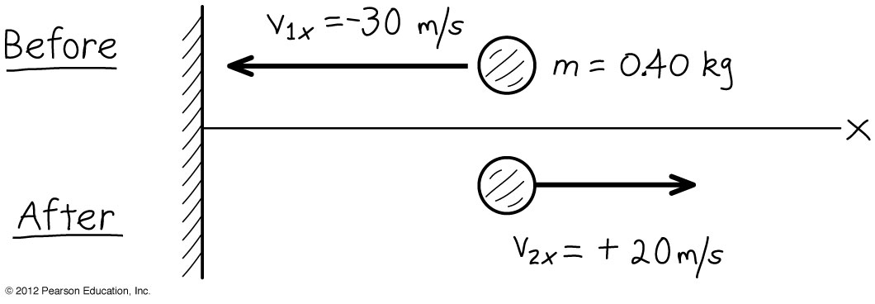
Example 1
You throw a ball with a mass 0.40 kg against a brick wall. It moves horizontally to the left at 30 m/s to hit the wall after which it rebounds horizontally to the right at 20 m/s. (a) Find the impulse of the net force on the ball during its collision with the wall. (b) If the ball is in contact with the wall for 0.010 s, find the average horizontal force that the wall exerts on the ball during the impact.
Notes:
(a) J_{x} = 20 N.s (b) (F_{av})_{x} = 2000 N

Slide 7
Internal and external forces
For any system of particles, the forces exerted by the particles on each other are called internal forces.
The forces exerted on any part of the system by objects outside it are called external forces.
If internal forces in a system are much larger than any external forces, we can treat the system as an isolated system.
For example, when two pucks on an air table collide, the internal force between them is much greater than the frictional force between the air and pucks.
The two pucks together can be regarded as an isolated system.

Slide 8
Law of conservation of momentum
Consider an isolated system in which objects A and B collide.
From Newton’s third law,

Slide 9
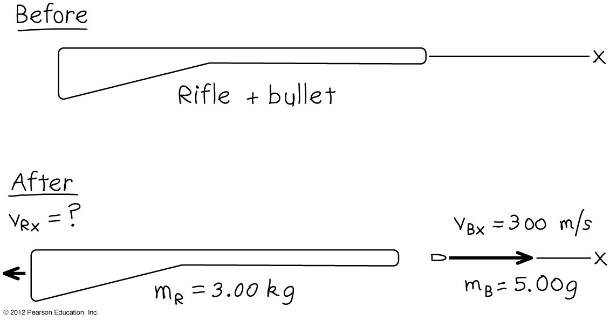
Example 2
A man holds a rifle of mass 3.00 kg loosely, so it can recoil freely. He fires a bullet of mass 5.00 g horizontally with a velocity 300 m/s (relative to the ground). (a) What is the recoil velocity of the rifle? (b) What are the final momentum and kinetic energy of the bullet and rifle?
Notes:
Recoil velocity = -0.500 m/s, negative sign indicates that it moving opposite direction to bullet.
Final momentum of bullet = 1.50 kg.m/s, Final KE of bullet = 225 J
Final momentum of rifle = -1.50 kg.m/s, Final KE of rifle = 0.375 J

Slide 10
Elastic, inelastic and completely inelastic collision
In an elastic collision, the internal forces are conservative and the total kinetic energy is conserved. The two objects separate after colliding.
In an inelastic collision the total kinetic energy is not conserved. The two objects separate after colliding.
In a completely inelastic collision the total kinetic energy is not conserved. The two objects stick together and move as one.
Note that total momentum is conserved whether the collision is elastic, inelastic or completely inelastic.

Slide 11
Elastic collision in one dimension
Two spheres m₁ and m₂ move along the line joining their centres and collide elastically.
From the principle of conservation of linear momentum, the total momentum of the two spheres is conserved.
u₁
u₂
m₁
m₂

Slide 12
Elastic collision in one dimension
For elastic collision, total KE is also conserved
Assuming u₁ ≠ v₁ and u₂ ≠ v₂
(2) ÷ (1) u₁ – v₁ = v₂ – u₂
or (u₁ – u₂) = (v₂ – v₁)
Hence the relative speed of approach before collision is equal to the relative speed of separation after collision.

Slide 13
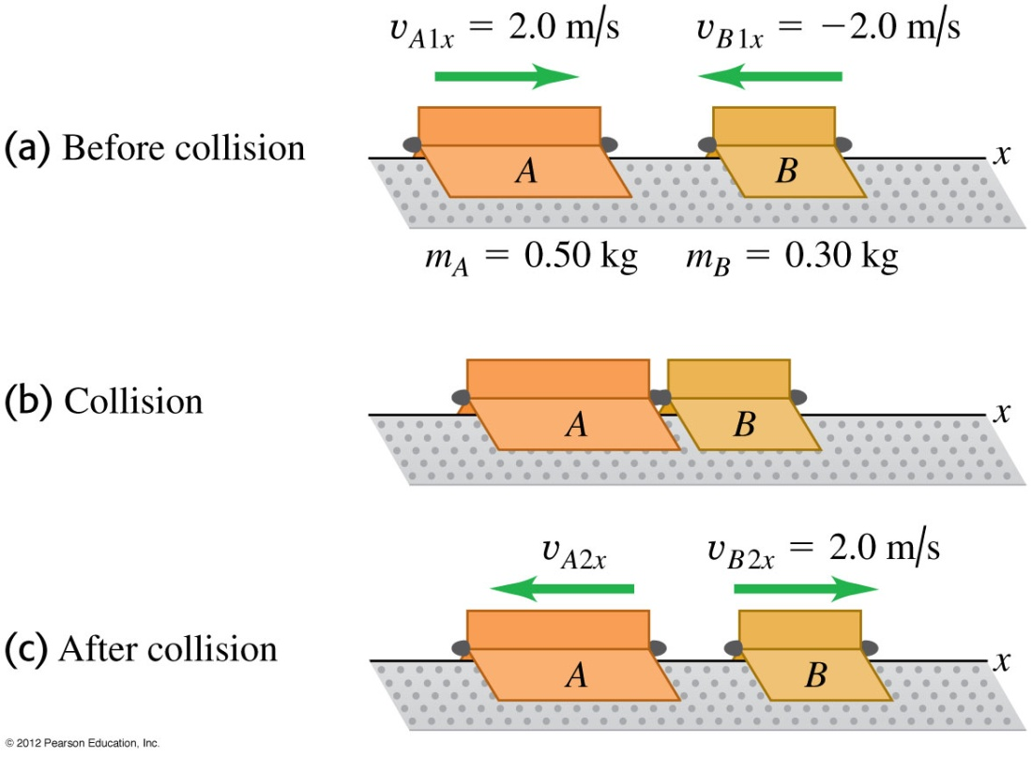
Example 3
Two gliders with different masses move towards each other on a frictionless air track. After they collide glider B has a final velocity of +2.0 m/s (see figures). (a) What is the final velocity of glider A? (b) How do the changes in momentum and in velocity compare?
Notes:
V = -0.40 m/s (b) ∆p_{A} = -1.2 kg.m/s, ∆p_{B} = 1.2 kg.m/s (c) ∆v_{A} = -2.4 m/s, ∆v_{B} = 4.0 m/s

Slide 14
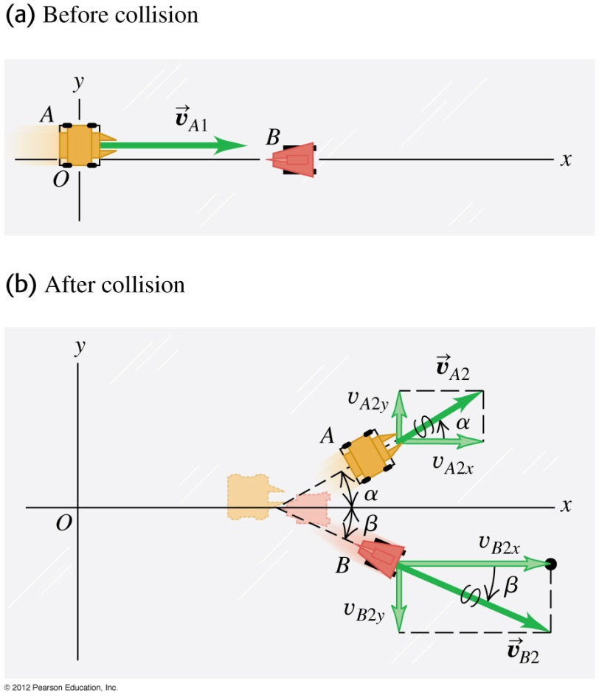
Example 4
The below figures show two robots namely A and B on a frictionless surface. Robot A with mass 20 kg initially moves at 2.0 m/s along x-axis towards robot B with mass 12 kg that is at rest. After the collision robot A moves at 1.0 m/s in a direction that makes an angle 30º with its initial direction. What is the final velocity of B?
Notes:
v = 2.1 m/s and angle is -24º with positive x – axis.

Slide 15
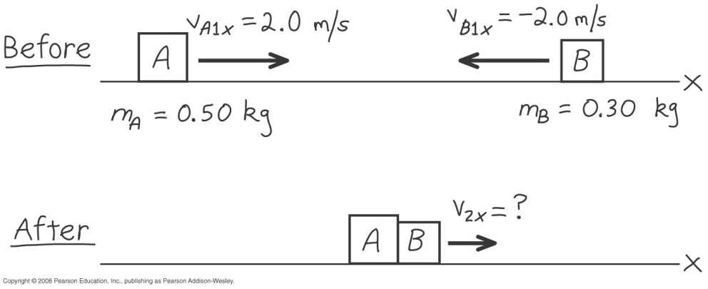
Example on inelastic collision
Two gliders with different masses move towards each other on a frictionless air track. After they collide both of them stick together and move. Find (a) the common velocity and (b) compare their initial and final kinetic energies of the system.
Notes:
V = 0.50 m/s (b) K_{i} = 1.6 J, K_{f} = 0.10 J

Slide 16
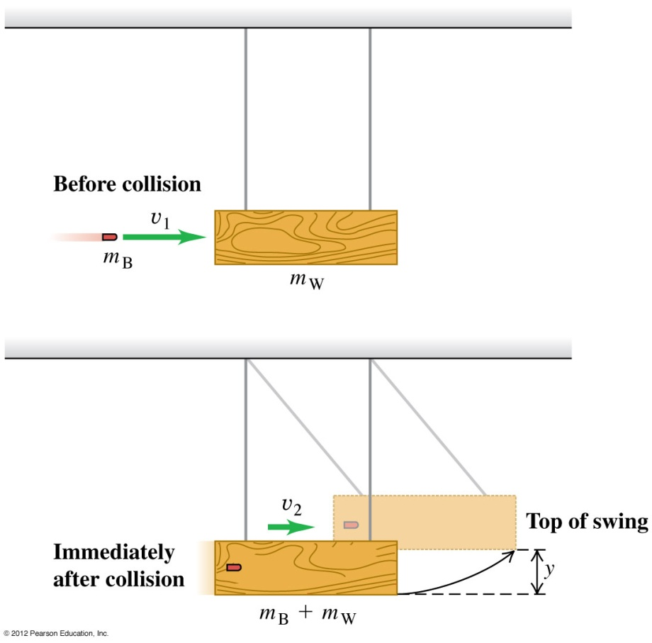
Example 5
The below figure shows a ballistic pendulum, a simple system for measuring the speed of a bullet. A bullet of mass m_{B} makes a completely inelastic collision with a block of wood m_{W} which is suspended like a pendulum. After the impact the block swings up to a maximum height y. Find the initial speed of the bullet v₁ in terms of y, m_{B} and m_{W} and acceleration due to gravity g.
Notes:
V₁ = [(m_{B} + m_{W})/m_{B} ]{2gy}^{1/2}

Slide 17
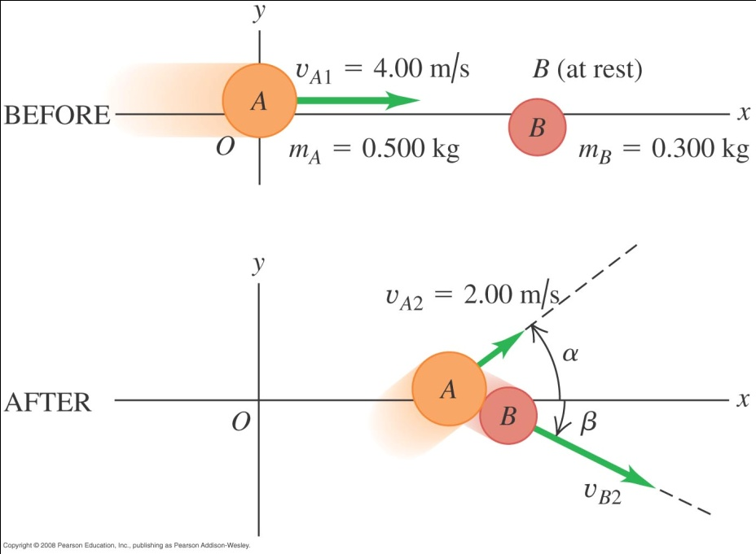
Example 6
The below figure shows an elastic collision of two pucks A and B of masses 0.500 kg and 0.300 kg respectively on a frictionless table. Puck A has an initial velocity of 4.00 m/s in the positive x-direction and a final velocity of 2.00 m/s in an unknown direction α. Puck B is initially at rest. (a) What is the final velocity of Puck B? (b) Find α and β.
Notes:
V = 4.47 m/s (b) αλπηα = 36.9^{ο}, βετα = 26.6^{ο}

Slide 18
Optional slides on rocket propulsion

Slide 19
Rocket propulsion
M
P_{i} = Mv
M – ΔM
P_{f} = (M – ΔM)(v + Δ v)

Slide 20
Rocket propulsion
Consider the system shown in fig (a) and fig (b).
Suppose an external force acts on the mass M at time t and the mass M ejects a small portion DM of it in the opposite direction.
y
t
y
t + Δ t
ΔM
M
M - ΔM
x
x
(a)
(b)

Slide 21
Rocket propulsion
The momentum of the mass M at time t is
The momentum of the mass at time t + Δt is

Slide 22
Rocket propulsion
As
Hence

Slide 23
Rocket propulsion
Rearranging, we get
Hence thrust (reaction force) on the rocket depends on
the exhaust speed relative to the rocket
the rate of change of mass (burn rate),

Slide 24
Example 7
A rocket stands vertically on its launching pad prior to ignition. The mass of the rocket and its fuel is 1.9 x 10³ kg. On ignition, gas is ejected from the rocket at a speed of 2.5 x 10³ kg/s relative to the rocket and fuel is consumed at a constant rate of 7.4 kg/s. Find the thrust on the rocket and hence explain why there is an interval between ignition and lift-off.
The delay is due to the inertia of the rocket and initial fuel load.

Slide 25
End of chapter

